Slide 1
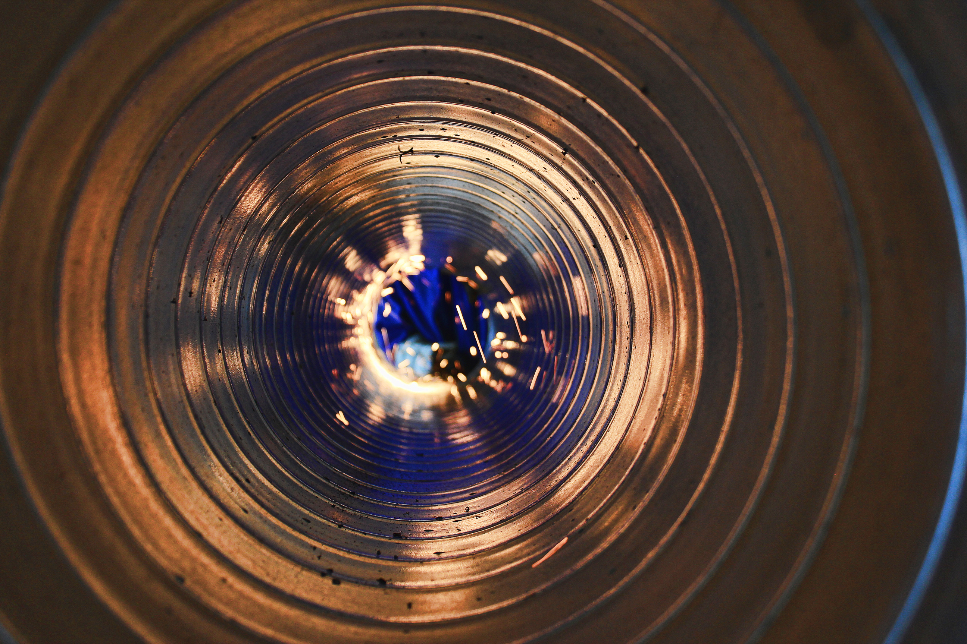
RandomForest Regressor House price practice
Ellen Tang
November 20, 2023
Version:1.0

Slide 2
Content
01
Introduction
02
What Dataset Will Use
03
Machine Learning Code Implementation-RandomForestRegressor
04
Predict Result

Slide 3
Introduction
Purpose
Use machine learning to create a model that predicts which House price.

Slide 4
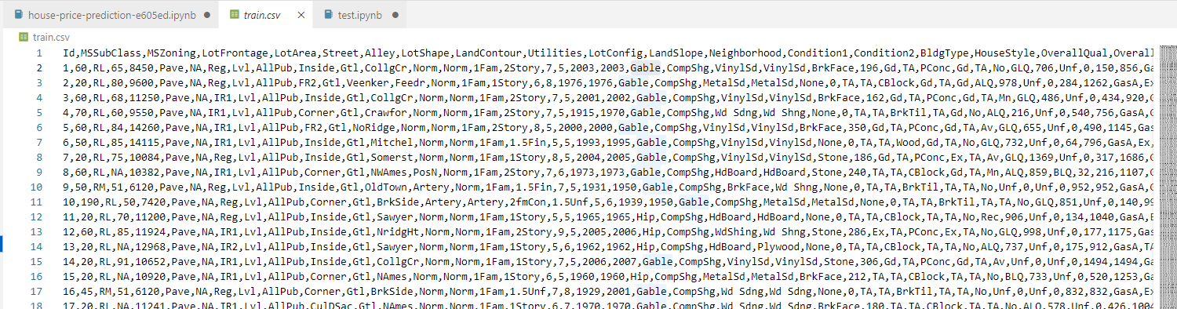
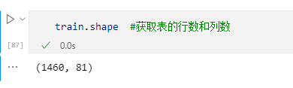
What Data Will Use
Train.csv
Contains detailed information about many houses information;

Slide 5
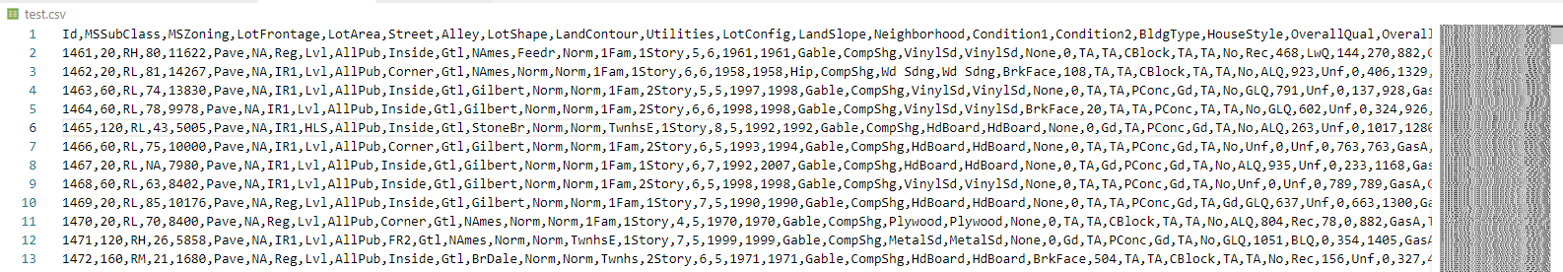
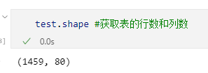
What Data Will Use
Test.csv
The dataset contains similar information but does not include the 'SalesPrice' column for each house in each dataset We need to predict these results.

Slide 6
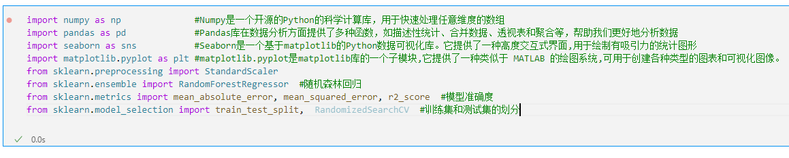
Code Implementation-RandomForestRegressor
Packages
will use pandas,sklearn,matplotlib eight packages in our solution

Slide 7
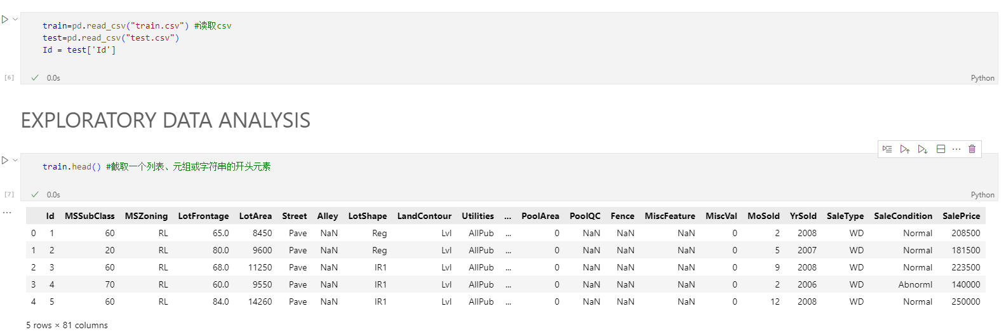
Code Implementation-RandomForestRegressor
obtain data from csv into dataframe

Slide 8
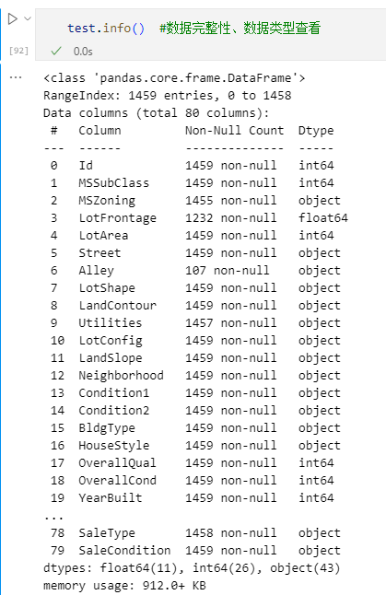
Code Implementation-RandomForestRegressor
Data integrity, data type viewing

Slide 9
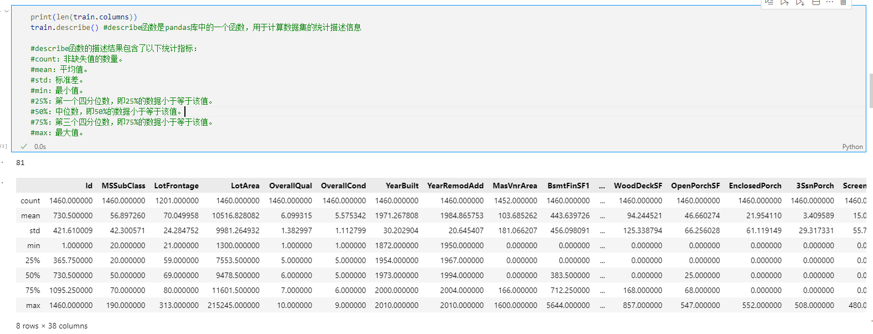
Code Implementation-RandomForestRegressor
Calculate statistical description information for train data

Slide 10
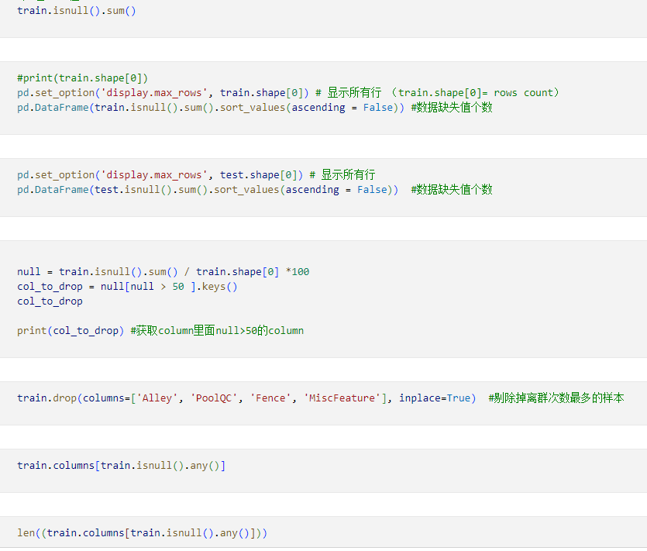
Code Implementation-RandomForestRegressor
Scrub Data

Slide 11
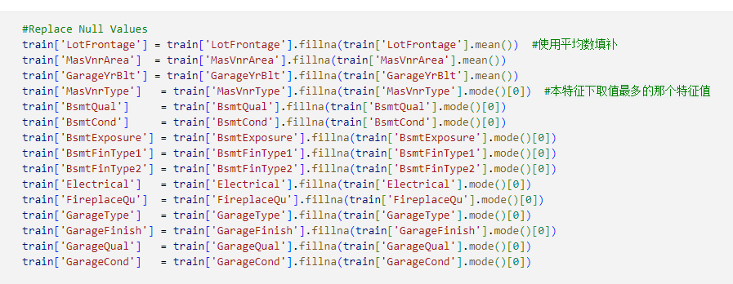
Code Implementation-RandomForestRegressor
Scrub Data and REPLACE NULL VALUES

Slide 12
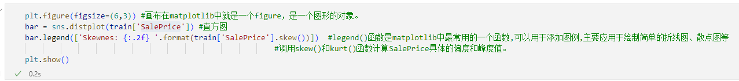
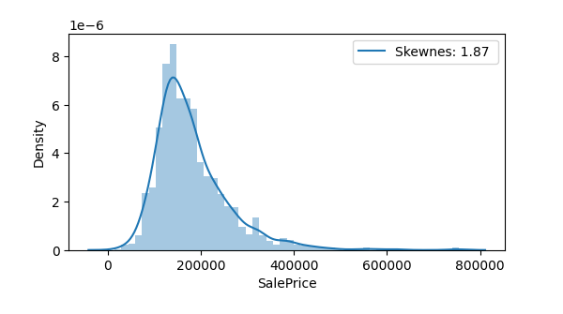
Code Implementation-RandomForestRegressor
PLOTTING

Slide 13
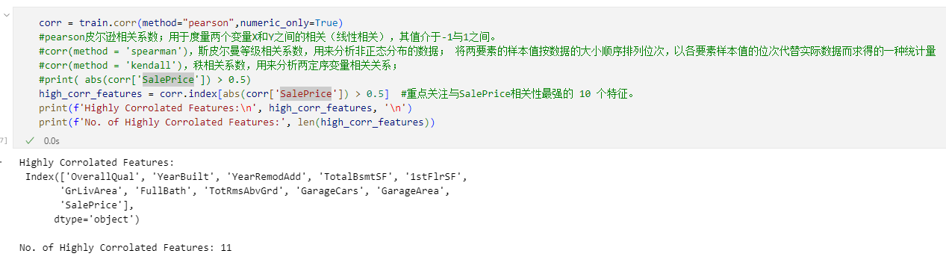
Code Implementation-RandomForestRegressor
FEATURE ENGINEERING

Slide 14
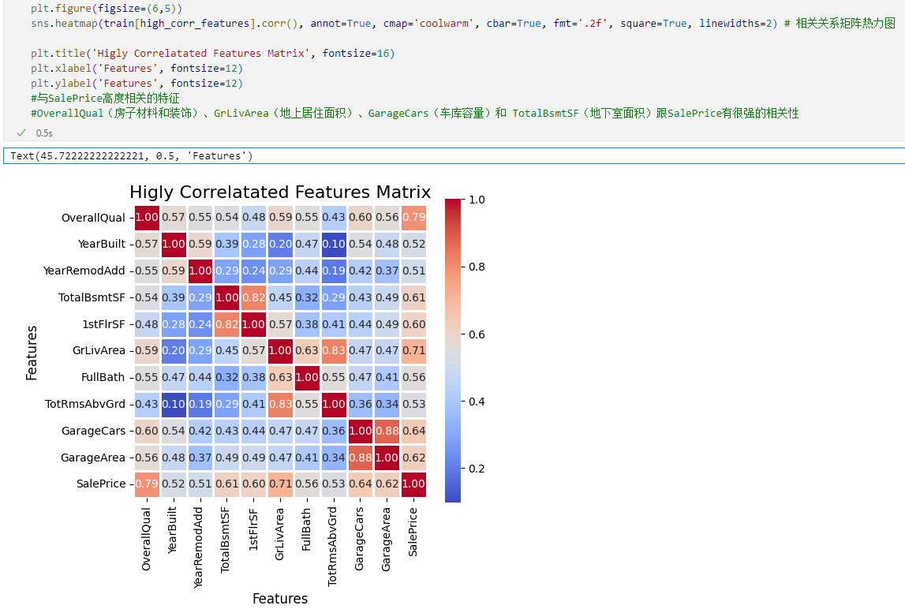
Code Implementation-RandomForestRegressor
FEATURE ENGINEERING

Slide 15
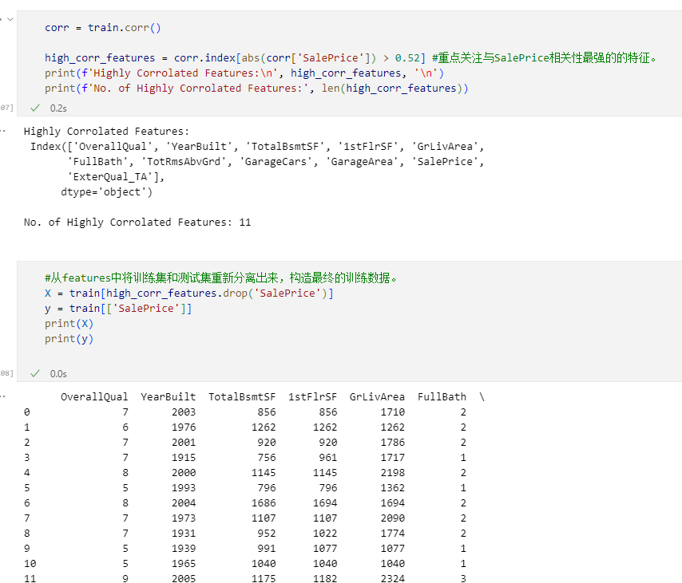
Code Implementation-RandomForestRegressor
SPLITTING DATASET
Transform data from string to number, in order to fulfill sklearn.preprocessing.train-_test_split requirement.

Slide 16
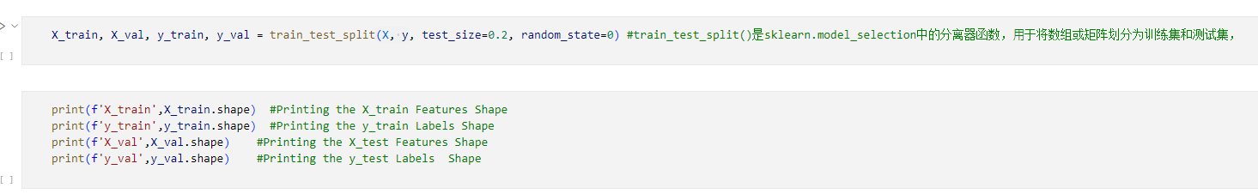
Code Implementation-RandomForestRegressor
Build models
to prepare data for train_test_split which will served for machine learning sampling. The test size ratio is 20%.

Slide 17
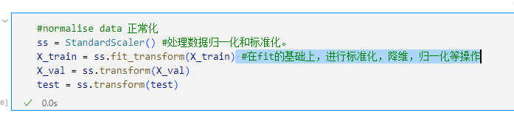
Code Implementation-RandomForestRegressor
Normalize data

Slide 18
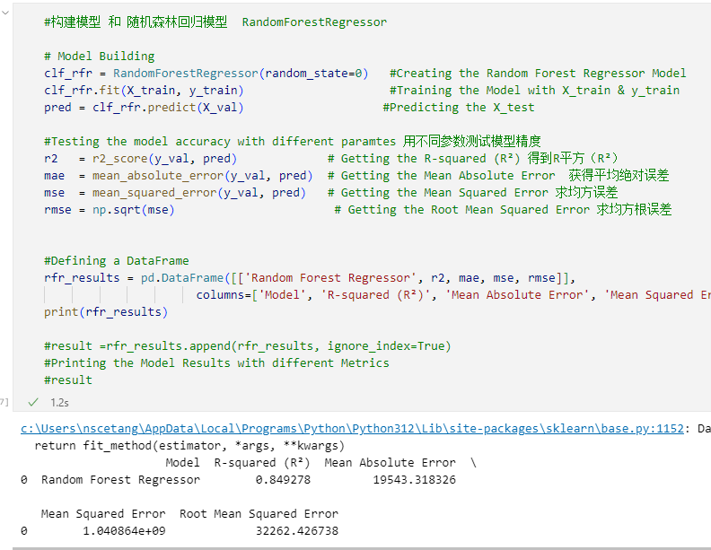
Code Implementation-RandomForestRegressor
Build models
call RandomForestRegressor, train the model with training data

Slide 19
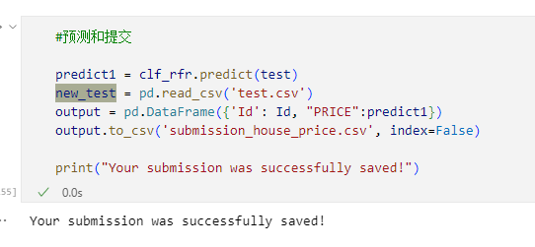
Code Implementation-RandomForestRegressor
Get predict result
call predict method, to get the predict result and output result to csv file.

Slide 20
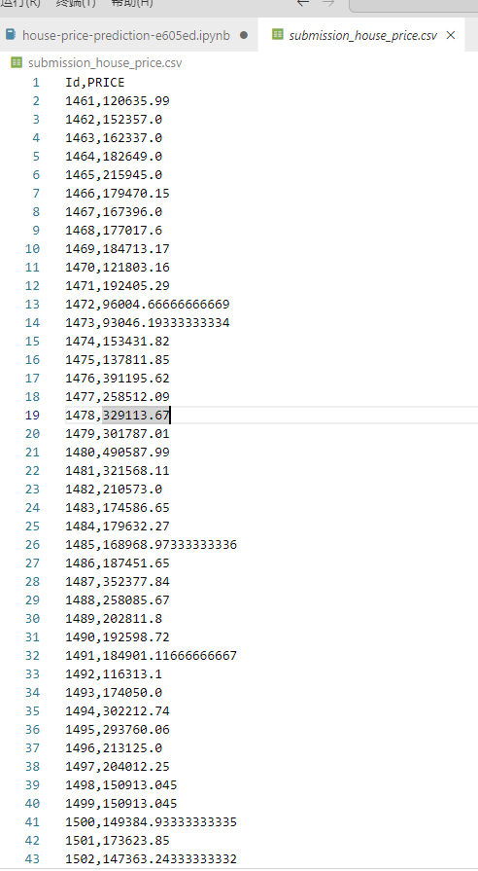
Predict Result

Slide 21
Thank You

